Slide 1

What is ES6 ?

Slide 2
আমি ধরেই নিচ্ছি
আপনি বিগিনার

Slide 3
What is ES6 ?
General Concept:
ES6 is a modern update of JavaScript
Widely knows as JS6
This is version of JavaScript
IN Depth:
ES6 or ECMAScript 6 is a scripting language.
ECMAScript is generally used for client-side scripting
used for writing server applications and services by using Node.js

Slide 4
Why should I learn ES6 ?
For React JS
For React Native
For Vue js
For Electron JS
Or Any Node.js dependent development

Slide 5
What I Cover?
ES6 Basic’s
ES6 Function’s
ES6 Array’s
ES6 Object
ES6 Class
ES6 String
ES6 Advance Feature’s

Slide 6
Tools
Node.js
WebStrom / VS Code

Slide 7
My First ES6 Program
Hello World

Slide 8

ES6 Basic Syntax
The syntax is the set of rules which defines the arrangements of symbols.
Literals: A literal can be defined as a notation for representing the fixed value within the source code.
Generally, literals are used for initializing the variables.
Variables: A variable is the storage location that is identified by the memory address.
Keywords: In Computer programming, a keyword is a word that has a special meaning in a specific context.
It cannot be used as an identifier like the variable name, function name, or label.
Operators: Operators are symbols that define the processing of operands.

Slide 9
ES6 Syntax
Case-Sensitive: uppercase characters and lowercase characters are different
Semicolons :The use of semicolons is optional in JavaScript.

Slide 10
ES6 Syntax
Case-Sensitive: uppercase characters and lowercase characters are different
Semicolons :The use of semicolons is optional in JavaScript.

Slide 11
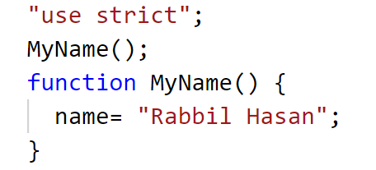
The Strict Mode – পুলিশ
পুলিশঃ চুরি করলে আপনাকে দমন করবে
Preventing you from using undeclared variables
পুলিশঃ আপনি অন্ধ হলে রাস্তা পাড় করে দিবে।
Removes some of the JavaScript silent errors by changing them to throw errors.
Fixes the mistakes, That is difficult for JS Engine to overcome

Slide 12
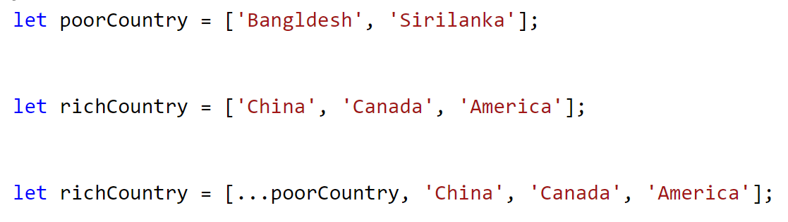
ES6 Spread Operator
Spread= প্রসার, বিস্তার
three dots (...).
Array কে প্রশস্ত করে নতুন ভেলু যোগ করে

Slide 13
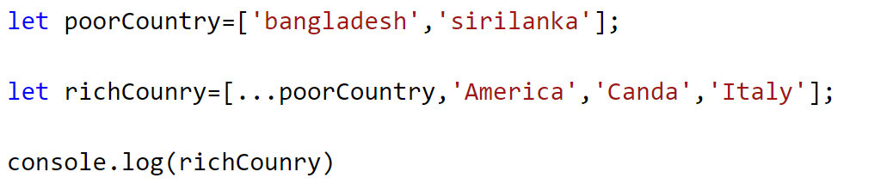
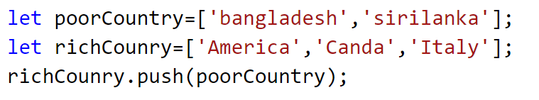
Without using spread operator

Slide 14
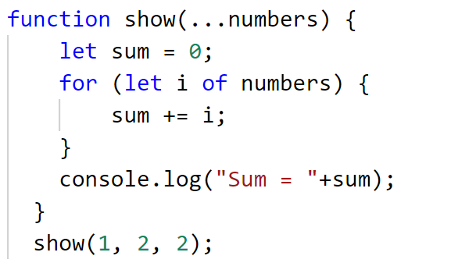
ES6 Rest Parameter
Using rest parameter, a function can be called with any number of arguments.
Rest parameter is prefixed with three dots (...).

Slide 15
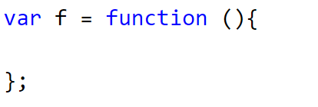
Dynamic function
Functions by using the function constructor.

Slide 16
ES6 Variables
Using let:
let keyword is assigned the block scope
let cannot be re-declared.
can be reassigned a value.
Using const:
It cannot be reassigned a value.
It is block scoped.
A constant cannot be re-declared.
Using var
let can be re-declared.
can be reassigned a value.

Slide 17
Variable Scope
Global Scope: In the global scope, the variable can be accessed from any part of the JavaScript code.
Local Scope: In the local scope, the variable can be accessed within a function where it is declared.

Slide 18
Variable Hoisting
Hoisting মানে উত্তোলন
Value assign আগে,
Declare পরে

Slide 19
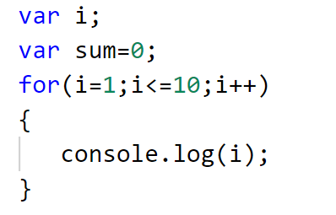
simple for loop

Slide 20
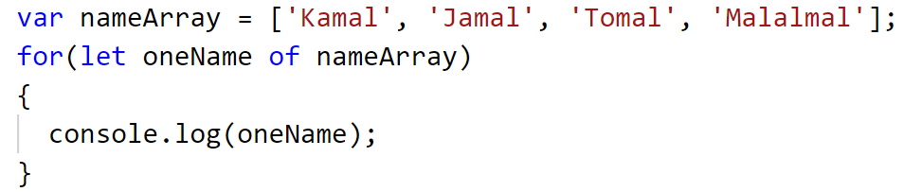
The for…of loop

Slide 21

Object

Slide 22
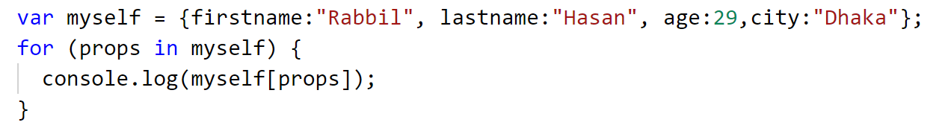
The for…in loop

Slide 23
ES6 Decision-Making
নতুন কিছু নেই -

Slide 24
ES6 Function
Simple Function
Parameterized functions
Rest Parameters
Returning functions
Anonymous function
Parameterized Anonymous function
Arrow functions
The Function Constructor

Slide 25
Anonymous function
A function without a name
It can be declared dynamically at runtime
An anonymous function can be assigned within a variable.

Slide 26
ES6 Arrow Function
To write smaller function syntax.
Arrow functions make your code more readable and structured.
Arrow functions are anonymous functions
Can declare without the function keyword.
………………………………………………………………………………..
Arrow functions cannot be used as the constructors.

Slide 27
ES6 Arrays
ES6 Arrays
ES6 Array Methods
ES6 Array destructuring
ES6 Map
ES6 Set

Slide 28


ES6 Arrays
Simple Array

Slide 29
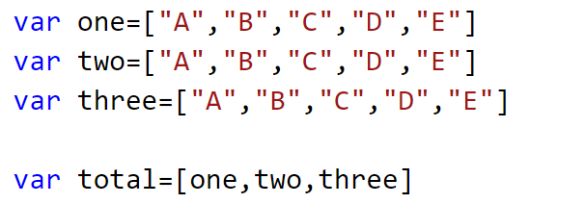
ES6 Arrays
ES6 Multidimensional Arrays

Slide 30
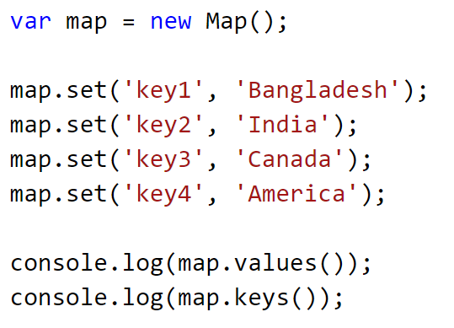
ES6 Arrays
ES6 Map
Map is a collection of data

Slide 31
ES6 Arrays
ES6 Map
Loop For Map Values and Keys

Slide 32
ES6 Arrays
ES6 Map
delete(key)
get(key)
clear()
has(key)

Slide 33
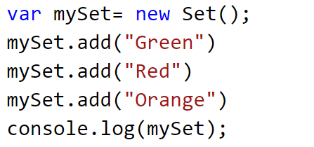
ES6 Arrays
ES6 Set
Set is a collection of data
Set is almost like array
But it does not contain any duplicates.

Slide 34
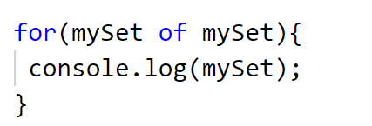
ES6 Arrays
ES6 Set

Slide 35
ES6 Arrays
ES6 Set
.clear()
.delete(value)
.has(value)
.values()
Set.size

Slide 36
ES6 Class
ক্লাস কেনো দরকার ?
Before ES6, it was hard to create a class in JavaScript.
But in ES6, we can create the class by using the class keyword

Slide 37
ES6 Class
ES6 Class And Object

Slide 38
ES6 Class
ES6 Class Constructor
Constructor হচ্ছে ক্লাসের নিজেস্ব মেথড/ফাংশন
ক্লাস অবজেক্ট তৈরি হলেই, Constructor অটো কল হয়
অন্য ফাংশনের মতোই Constructor কাজ করে
কিন্তু Constructor রিটার্ন করতে পারে না

Slide 39
ES6 Class
Static Keyword:

Slide 40
ES6 Class
Without Static Keyword:
Class Object
Properties
Direct Class

Slide 41
ES6 Class
With Static Keyword:
Class Object
Properties
Direct Class

Slide 42
ES6 Class
Class Inheritance
Parent Class
উত্তরাধিকার
Child Class

Slide 43
ES6 Class
Class Inheritance
বাবার ক্ষমতা
ছেলের ক্ষমতা

Slide 44
ES6 Class
Super Keyword

Slide 45
ES6 Module
Module – জোট,একত্রিত কিছু
ES6 Module Export – ES6 Module Import
Modules make it easy to maintain the code
Debug the code
Reuse the piece of code

Slide 46
Module Export Import
Class Export
Function Export
Variable Export
Class Import
Function Import
Variable Import
Named : Export-Import By Using Same Name
Default: Export – Import By Using Any Name

